Slide 1
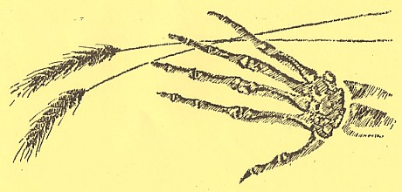
Ukrainian Famine - Genocide
Holodomor 1932-33
Saskatchewan Ministry of Education 2007
Saskatchewan Ministry of Education © 2007
Notes:
Saskatchewan Ministry of Education 2007

Slide 2
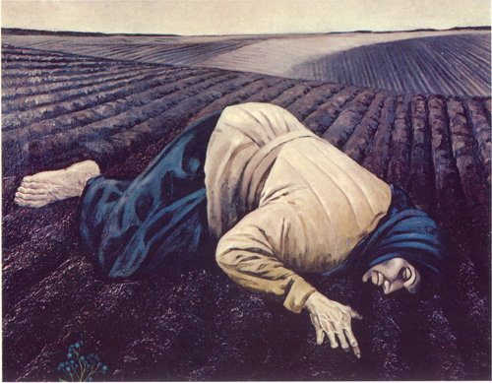
What does “Holodomor” mean?
Holodomor, one of the most horrific genocides in history, took place 75 years ago. This word means death by starvation in the Ukrainian language.
Slide 2
Saskatchewan Ministry of Education 2007
Saskatchewan Ministry of Education © 2007
Notes:
Saskatchewan Ministry of Education 2007

Slide 3
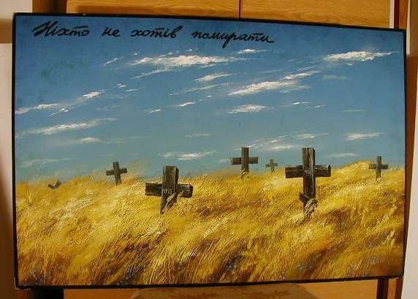
When did this happen?
During the winter of 1932 and the spring of 1933, millions of people living in central and eastern Ukraine were wiped out by a forced famine. Entire villages of people died.
Slide 3
Saskatchewan Ministry of Education 2007
Saskatchewan Ministry of Education © 2007
Notes:
Saskatchewan Ministry of Education 2007

Slide 4
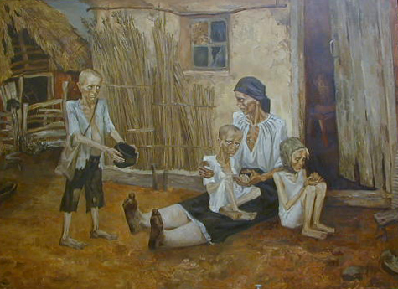
How many people perished?
Between 7 and 10 million Ukrainians were starved to death. People of all ages were victims of this tragedy - the elderly, young women and men, innocent children and infants.
Slide 4
Saskatchewan Ministry of Education 2007
Saskatchewan Ministry of Education © 2007
Notes:
Saskatchewan Ministry of Education 2007

Slide 5
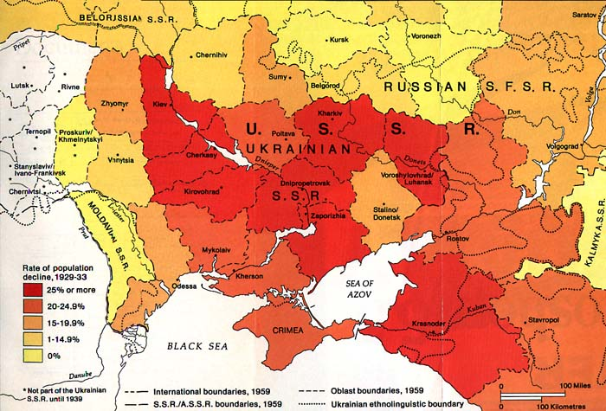
Which regions were most severely affected?
Note the areas which appear in dark red
Slide 5
Saskatchewan Ministry of Education 2007
Saskatchewan Ministry of Education © 2007
Notes:
Saskatchewan Ministry of Education 2007

Slide 6
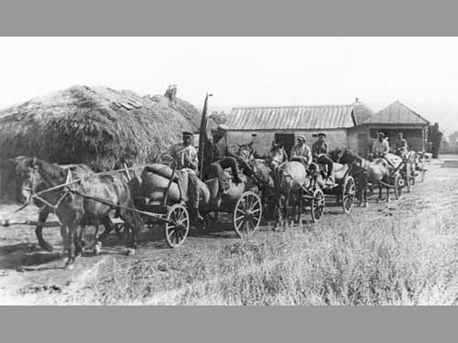
How did this happen?
In the fall of 1932, by decree of Joseph Stalin, Ukrainian villagers were forced to supply all of their grain to the Soviet* government.
Soviet = U.S.S.R. or Union of Soviet Socialist Republics
Slide 6
Saskatchewan Ministry of Education 2007
Saskatchewan Ministry of Education © 2007
Notes:
Saskatchewan Ministry of Education 2007

Slide 7
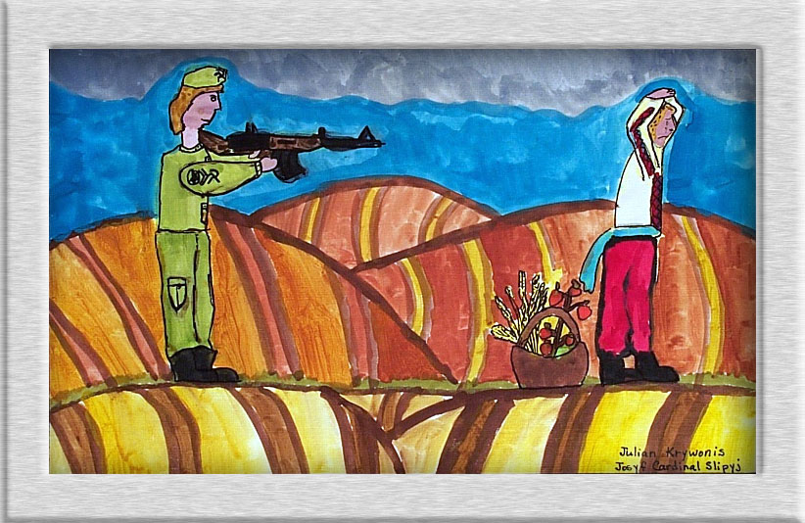
What happened if they didn’t comply?
If the villagers did
not supply every
grain of wheat to the
Soviet government,
they were shot to
death. They could
not even keep a few
grains to feed their
family.
Slide 7
Saskatchewan Ministry of Education 2007
Saskatchewan Ministry of Education © 2007
Notes:
Saskatchewan Ministry of Education 2007

Slide 8
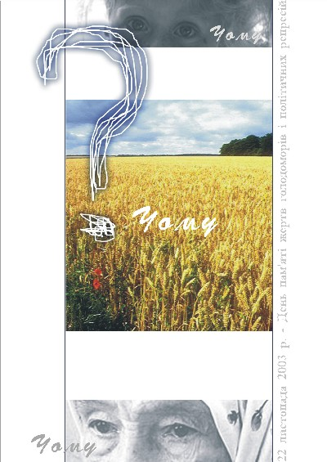
Why did this happen?
The Ukrainian people did not want to give up their land for collectivization*. Imagine the irony! Villagers harvested record crops of wheat, but died of hunger because they were not allowed to keep it.
Collectivization – the process of creating collective farms in the USSR.
Slide 8
Saskatchewan Ministry of Education 2007
Saskatchewan Ministry of Education © 2007
Notes:
Saskatchewan Ministry of Education 2007
-

Slide 9
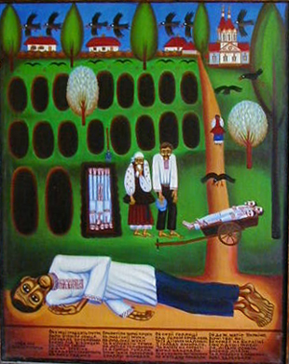
Why haven’t we heard about the Holodomor?
Until 1991, the Soviet government suppressed all information about this piece of history. Ukrainian people refused to forget all the dear loved ones who died unjustly. They are now free to share their story.
Slide 9
Saskatchewan Ministry of Education 2007
Saskatchewan Ministry of Education © 2007
Notes:
Saskatchewan Ministry of Education 2007

Slide 10
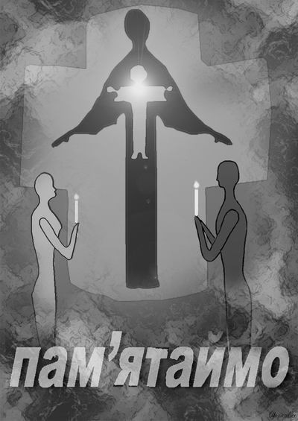
Are there any survivors of the
Holodomor?
Ukraine became a free country in 1991. Eye-witnesses who survived the tragedy were able to speak openly about the Holodomor of 1932-33 to their children, grandchildren and Ukrainian historians.
Slide 10
Saskatchewan Ministry of Education 2007
Saskatchewan Ministry of Education © 2007
Notes:
Saskatchewan Ministry of Education 2007

Slide 11
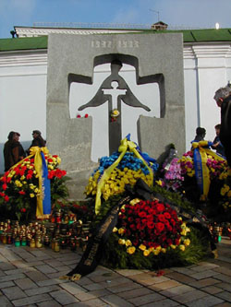
How is this history being shared?
In 1991, the book “Famine of ‘33: Memorial Book” was published in Kyiv. It lists the names of one thousand survivors of the Holodomor, who witnessed the tragic deaths by hunger.
Slide 11
Saskatchewan Ministry of Education 2007
Saskatchewan Ministry of Education © 2007
Notes:
Saskatchewan Ministry of Education 2007

Slide 12
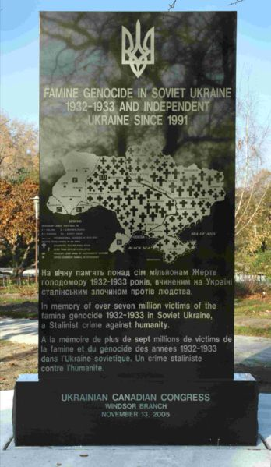
What is our role today?
As a tribute to the
millions who died, we
must acknowledge
the Holodomor, or
famine-genocide, in
our history texts. It
happened because of
greed, power and a
lack of respect for
human life.
Slide 12
Saskatchewan Ministry of Education 2007
Saskatchewan Ministry of Education © 2007
Notes:
Saskatchewan Ministry of Education 2007

Slide 13
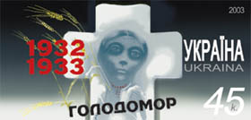
Photo Credits
1. Illustration – Ukrainian Genocide Foundation (Chicago, USA)
2 “Zemlia”. Painting by Bohdan Pevny, New York (1963)
3. “Nobody Wanted To Die, 1932-33” by unidentified Ukrainian Poster Artist.
4. Famine in Ukraine 1932-33. Painting by Nina Marchenko.
5. Map – Reproduced from ‘Wikipedia’ Holodomor information article.
6. Photo – Grain Being Taken From Collective Farms – unknown source.
7. Art Exhibit ‘Through The Eyes of A Child’. Student Art by J. Krywonis. (2000) UCC-Toronto Branch.
8. Chomu? – Poster by Maria Dusenko (Donets’k)
9. “Oh, In The Year of Thirty-Three”. Painting by Ivan Novobranets’ (Poltava)
10. “Remember” – Poster by Ol’ha Markova (Kyiv)
11. Holodomor Memorial, Kyiv, Ukraine (22/11/2003). Art Ukraine.com Information Service.
12. Holodomor Memorial - Windsor, Ontario (2005) UCC-Windsor Branch
13. Official Holodomor Commemorative Stamp (2003) Marka Ukrayiny
14. Holodomor Commemoration – Pysanka by Ivan Mishchenko (Cherkassy Oblast) 1999.
Slide 13
Saskatchewan Ministry of Education 2007
Saskatchewan Ministry of Education © 2007
Notes:
Saskatchewan Ministry of Education 2007

Slide 14
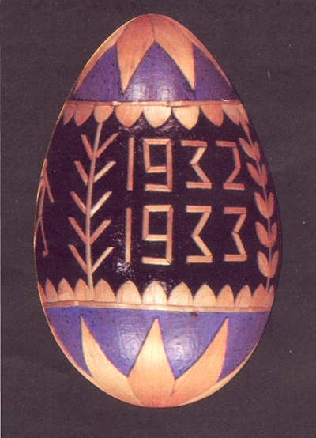
Recommended Resources
www.faminegenocide.com
www.en.wikipedia.org/wiki/Holodomor
http://www.ucc.ca/media_releases/2007-06-05/index.htm
www.holodomor.org.uk/Portals/0/Holodomor_Presentation.pdf
www.artukraine.com/famineart/
www.artukraine.com/famineart/mackinnon.htm
www.infoukes.com/history/famine
www.lucorg.com/luc/holodomor.php
http://www.holodomor.org
www.ukrajinci.hu/holod/32-33.htm
Slide 14
Saskatchewan Ministry of Education 2007
Saskatchewan Ministry of Education © 2007
Notes:
Saskatchewan Ministry of Education 2007

